Slide 1
Chapter 12
Safe Work Practices
Drum and Container Handling

Slide 2
Learning objectives
This chapter discusses how to safely handle drums and other containers of hazardous waste and hazardous materials.
After completing this chapter, you will be able to demonstrate your ability to:
1. IDENTIFY the proper method to inspect a drum before handling.
2. IDENTIFY the proper method to open a drum.
3. IDENTIFY the proper method to take a sample from a drum.

Slide 3
4. IDENTIFY the proper method for using a salvage drum.
5. IDENTIFY the purpose of staging drums.
6. IDENTIFY safe work practices to minimize risks presented by handling materials on a hazardous waste site.

Slide 4
Safe Work Practices: Materials Handling
Proper safe work practices are essential to prevent
accidents when handling drums and other containers
Bottles
Bags
Cylinders
Tanks
Cans
Drums
29 CFR 1910.120 (e) (2) (iv)
Chapter 12
Safe Work Practices
211

Slide 5
Safe Work Practices: Materials Handling
Cleaning up a hazardous waste site often involves
Finding drums
Assessing their condition
Identifying their contents
Organizing (staging) them for shipment and disposal
29 CFR 1910.120 (e) (2) (iv)
Chapter 12
Safe Work Practices
211

Slide 6

Safe Work Practices: Materials Handling
Accidents can occur when handling drums and other containers
Fire
Explosion
Chemical reaction
Release of hazardous substances
29 CFR 1910.120 (e) (2) (iv)
Chapter 12
Safe Work Practices
211

Slide 7
Visual Inspection
Before sampling, moving or otherwise handling a drum or other container, perform a visual inspection:
Look for labels that might identify the contents
Look for deterioration, corrosion, or leaks
Look for signs that the container is under pressure. Is it swelled or bulging? Attempting to open or move a pressurized drum could cause serious exposure and possibly an explosion
How does it open? Note what type of head and bungs (plugs) a drum has
Chapter 12
Safe Work Practices
211

Slide 8
Environmental Monitoring
The Site Safety and Health Plan may require air monitoring near drums
The presence of contaminants can indicate that chemicals are escaping
Chapter 12
Safe Work Practices
212

Slide 9
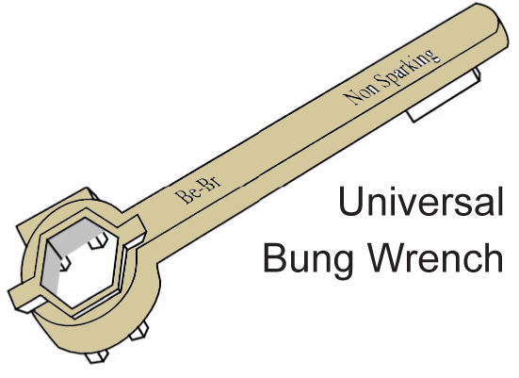
Opening Drums
It can be very dangerous to open a drum, especially
if you don’t know for certain what it contains.
Use a face shield, protective clothing
and a respirator if required by the
Site Safety and Health Plan
Use the buddy system
Do a visual inspection
Chapter 12
Safe Work Practices
212

Slide 10
Opening Drums
Remove any water from the top the drum
The safest way to open a drum is to use a remote mechanical
opening device
If you have to unscrew a bung by hand:
Use a non-sparking bung wrench to reduce the possibility
of a static spark which could ignite flammable vapors
Turn the bung slowly. Even a non-sparking tool cannot
prevent friction between the threads on the drum and the bung
If you hear hissing, wait for the pressure to release before
continuing to turn the bung
Chapter 12
Safe Work Practices
212

Slide 11
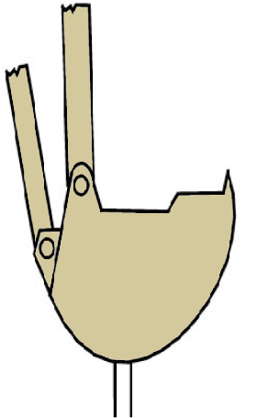
Remote Drum Opening Equipment
There are several types of remote drum opening equipment:
A metal spike welded to the bucket of a backhoe
Remote hydraulic or pneumatic puncture device,
drum deheader or impact bung wrench
Chapter 12
Safe Work Practices
213

Slide 12
Taking a Sample From a Drum
A container may require sampling to identify its contents,
or determine its flash point, pH, or water solubility.
Follow the procedure in the Site Safety and Health Plan
The plan should specify:
Which drums to sample
What the drums are likely to contain
Standard operating procedures for opening the drums and taking samples
Personal protective equipment including face shields,
protective clothing and respirator
Chapter 12
Safe Work Practices
213

Slide 13

Handling Drums
There are two main hazards associated with
handling drums and other containers:
Chemical hazards, including toxic exposure,
dangerous reactions, fire and explosion
Ergonomic injuries from heavy or improper lifting
Chapter 12
Safe Work Practices
214

Slide 14

Drum Staging
Drum Staging is the process of organizing drums:
In an orderly manner that allows easy and safe access
for personnel and equipment
In categories by chemical compatibility
Staging areas should be carefully designed
The surface should be paved
Covered with gravel with a plastic liner underneath
There should be a berm or dike around the area
A system to catch runoff
Chapter 12
Safe Work Practices
214

Slide 15

Salvage Drums
Often damaged or leaking drums are put inside
of a larger salvage drum. The safest procedure
is to use mechanical equipment. If done by hand:
Set both the drum and the salvage drum on their sides.
Work the drum part way into the salvage drum and then
roll them both on an angle until the drum is completely
inside. Then turn the salvage drum upright
Place the salvage drum upside down over the other
drum, and then carefully turn them both over
Chapter 12
Safe Work Practices
215

Slide 16
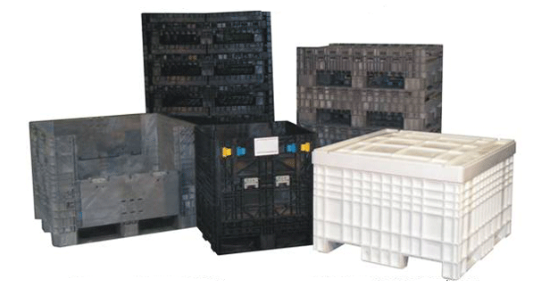
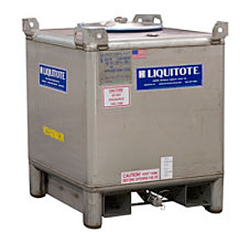
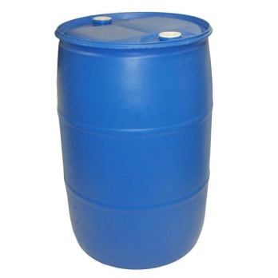
Bulking
Bulking means to transfer hazardous waste into a larger (bulk)
container such as a tank in order to transport the waste off site.
Chapter 12
Safe Work Practices
215

Slide 17
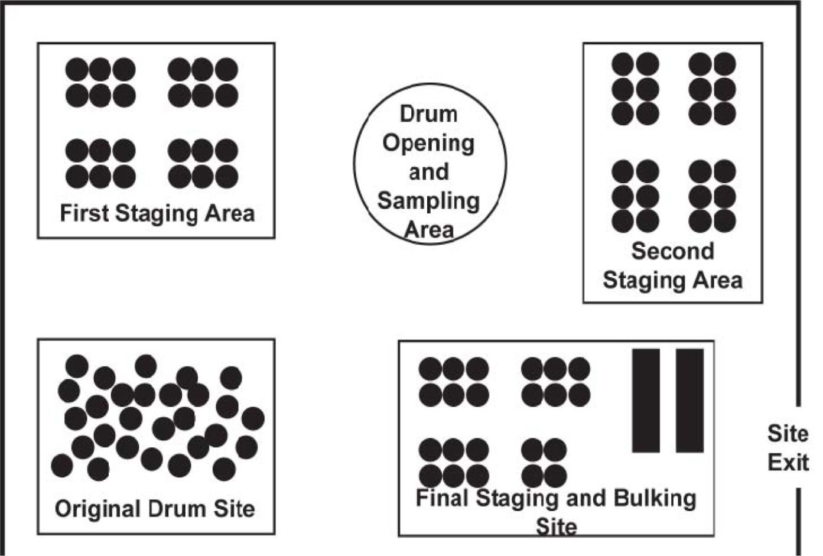
Example Staging Areas
Site Safety and Health Plan
Chapter 12
Safe Work Practices
215

Slide 18
Review Questions for Chapter 12
1. Describe how to inspect a drum or other container.
2. Describe the proper method to open a drum.
3. Describe the proper method to sample a drum.
4. Describe the proper method to place a damaged drum inside of a salvage drum.
5. What is the reason for staging drums.
MAIN MENU

