Slide 1
Chapter 4 Medical Surveillance

Slide 2
Learning Objectives This chapter discusses the medical examinations that you are required to have if you work at a hazardous waste site. After completing this chapter, you will be able to demonstrate your ability to: 1. EXPLAIN the purpose of medical surveillance. 2. IDENTIFY the four types of workers covered by the HAZWOPER medical surveillance requirements. 3. IDENTIFY when medical exams are required. 4. DESCRIBE the four main parts of an occupational medical exam.

Slide 3
What is Medical Surveillance?
Means keeping track of workers’ health by providing occupational medical exams and maintaining medical records
Who is Covered?
Workers who might be exposed to hazardous substances at or above the PEL for thirty (30) or more days a year
Workers who wear a respirator on thirty (30) or more days a year
Workers who are members of a HAZMAT emergency response team
Workers who are injured due to overexposure form an emergency incident involving hazardous substances or other health hazards
Chapter 4
Medical Surveillance
97

Slide 4
When Do You Need a Medical Exam?
Occupational medical exams as follows: [29 CFR 1910.120(f)(3)(i) and 1926.65(f) (3)(i)]
Prior to employment
Once a year after you start working
When you cease employment as one of the first three categories of worker covered by medical surveillance
As soon as possible after you develop signs or symptoms of overexposure to hazardous substances, or after you have been injured or exposed to a hazardous substance above the PEL in an emergency situation
Chapter 4
Medical Surveillance
98

Slide 5
When Do You Need a Medical Exam?
Occupational medical exams: [29 CFR 1910.120(f)(3)(ii) and 1926.65(f)(3)(ii)]
As soon as possible after the incident where you were overexposed
At additional times if the examining physician determines that follow-up exams are necessary
Chapter 4
Medical Surveillance
98

Slide 6
What is the Purpose of Medical Surveillance?
To assess your health and fitness for work, including whether you can wear a respirator
To detect early warning signs and symptoms of occupational disease and overexposure
Medical surveillance also provides information for:
Studies of the effects of workplace exposures
Evaluation of the effectiveness of control measures to prevent or limit exposures
Insurance claims and litigation
Chapter 4
Medical Surveillance
99

Slide 7
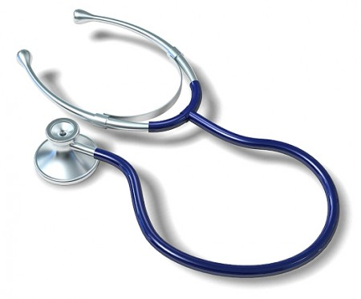
What Doctor Do You See?
You want to see a doctor who is Board Certified in Occupational medicine
Medical exams must be performed by a licensed physician. The HAZWOPER Standard says, “preferably one knowledgeable in occupational medicine.”
Chapter 4
Medical Surveillance
99

Slide 8
Who Pays for the Exam?
Employer pays for medical exams required by HAZWOPER
Who Sees the Results of the Exams?
Your employer receives a written opinion limited to medical conditions related to your work:
Whether or not you have a medical condition that would place you at risk of health problems if you work with hazardous substances
Chapter 4
Medical Surveillance
100

Slide 9
Who Sees the Results of the Exams?
Whether or not you are able to wear a respirator without incurring a risk to your health
Whether or not the physician recommends any limitations on your work or respirator use
Your exam results are confidential
Chapter 4
Medical Surveillance
100

Slide 10
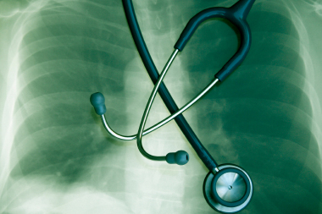
Occupational Medical Exams
An occupational medical exam includes four parts:
Work history
Medical history
Physical examination
Laboratory tests
Chapter 4
Medical Surveillance
101

Slide 11
Work History
The physician asks you questions to determine your work history:
Previous employers and job duties
Work locations
Types of work place exposures, including both chemicals and physical agents
Military service
Chapter 4
Medical Surveillance
101

Slide 12
Work History
Work related injuries and illnesses
Use of personal protective equipment
Exposures from hobbies or work around the house
Exposures of other family members that might affect you
Chapter 4
Medical Surveillance
101

Slide 13
Medical History
Information gained by a physician by asking specific questions to determine medical history
All medical problems, diseases and injuries you have had. Special attention should be given to asthma, lung disease, heart disease, liver and kidney problems, stress, allergies and skin conditions
Medical treatment, operations, physical therapy and prescribed drugs you have had or are currently taking
Chapter 4
Medical Surveillance
102

Slide 14
Medical History
Family medical history including diseases which your parents, brothers and sisters or other close relative have had
Personal habits (smoking, drinking, exercise, etc.)
Chapter 4
Medical Surveillance
102

Slide 15
Physical Exam
Doctor exams your body
General appearance and fitness
Vital signs (heart rate, weight, temperature, etc.)
All parts of your body, including skin conditions
Muscle and skeletal condition
Eyes
Ears
Chapter 4
Medical Surveillance
102

Slide 16
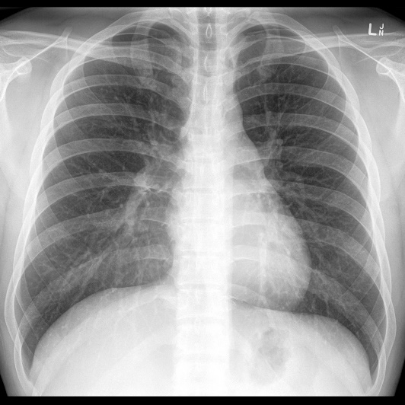
Laboratory Tests
Part of the medical exam
Establish base line information to compare to the results of tests conducted in the future
Find medical conditions that cannot be diagnosed from the physical exam alone
Measure the levels of work related chemicals or their metabolites in your body
Chapter 4
Medical Surveillance
103

Slide 17
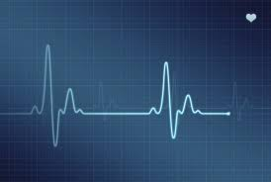
Laboratory Tests
Common laboratory tests
Lung function test
EKG
Chest X-ray
Urinalysis and blood tests
Chapter 4
Medical Surveillance
103

Slide 18
Limitations of Medical Monitoring
Routine, medical examinations do not guarantee that you will not become ill in the future
Many diseases do not have tests for early diagnosis.
Tests sometimes give false results
The doctor must know what possible exposures the worker faced. This means that the employer must provide good exposure assessment, chemical inventories, and record keeping
Chapter 4
Medical Surveillance
103

Slide 19
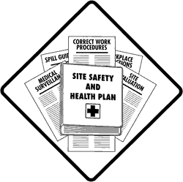
Make It Work for you
How Medical surveillance program can work for you
Read the specifics of the medical surveillance program in the site Safety and Health Plan. See if it complies with the HAZWOPER requirements
Learn the meaning of the medical words that are used to describe the program
Use the site Safety and Health Plan to find out what exposures are possible at the site
Chapter 4
Medical Surveillance
104

Slide 20
Make It Work for you
Obtain all the information you can about exposures using your rights under the OSHA.
Ask about the qualifications of the physician who administers the occupational medical exams. Keep a personal written log of all exposures at work.
Chapter 4
Medical Surveillance
104

Slide 21
Review Questions for Chapter 4
1. What are the four types of workers for whom a medical surveillance program is required?
2. What are the four main parts of an occupational medical exam?
3. What are two main reasons for medical surveillance?
4. When are you required to have a medical exam?
MAIN MENU

